Slide 1




Slide 2



Slide 3


▪
You need a GitHub account to submit questions and assignments!
Sign up for GitHub
How to ask questions
How to submit assignments

Slide 4
GitHub Sign-Up

Slide 5

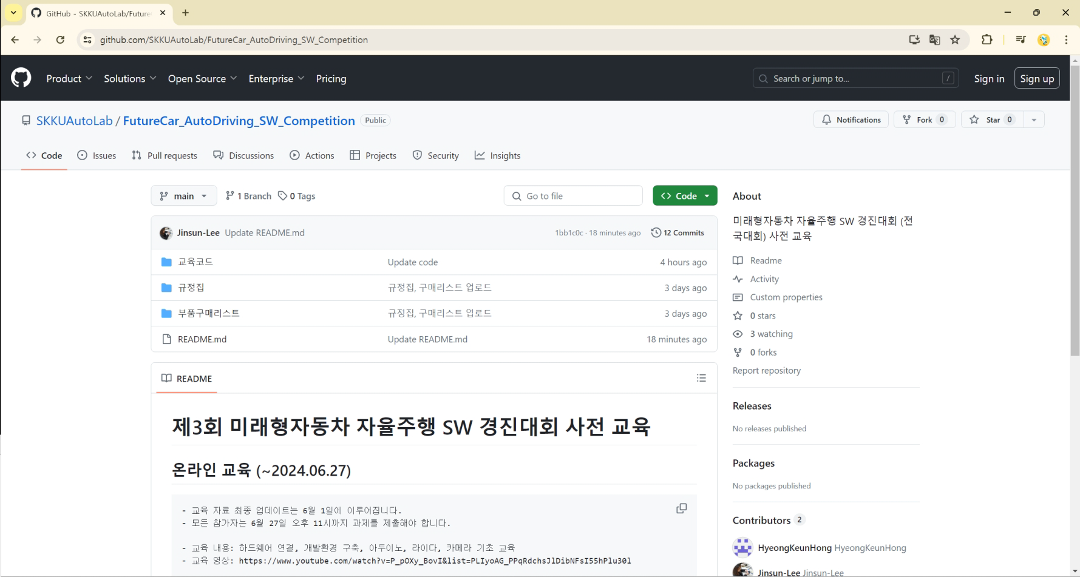
When you access the site via the link, the following screen will appear.
▪

Slide 6
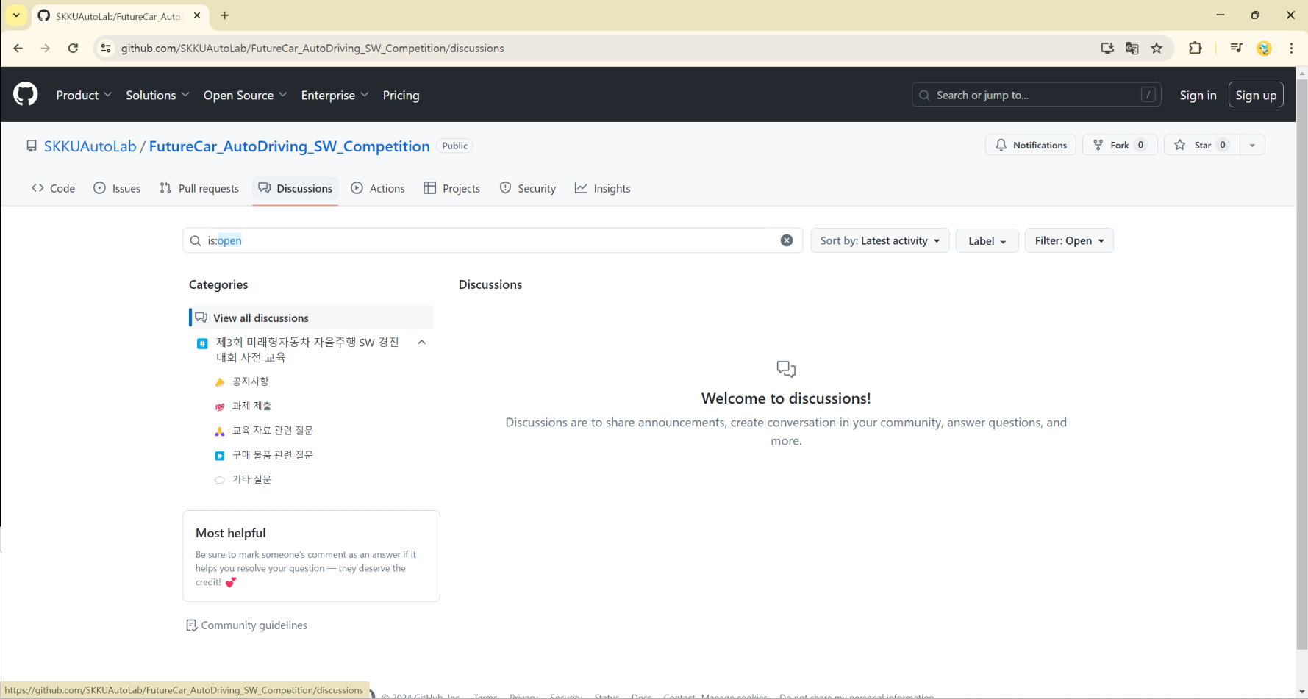
Click on the highlighted section ("Discussions") to see the following screen.
▪

Slide 7
Click on the highlighted section ("Sign up") to sign up for GitHub.
▪

Slide 8
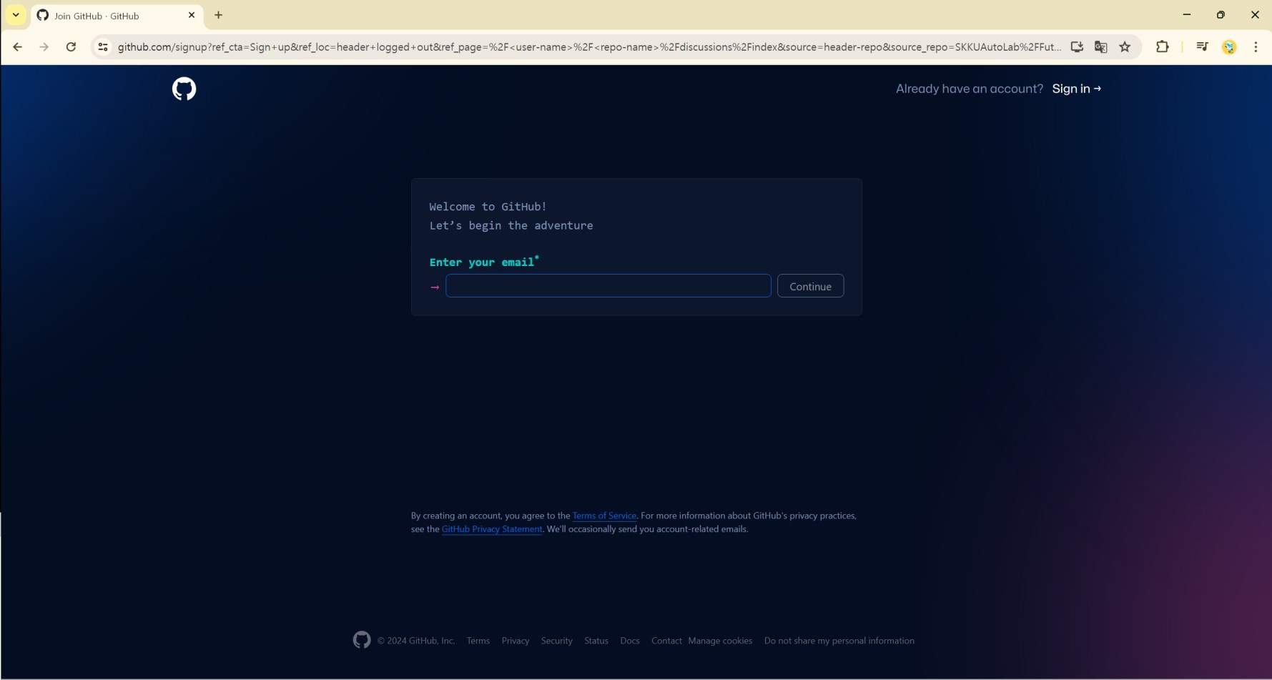
Clicking the highlighted section on the previous page will display the following screen.
▪

Slide 9
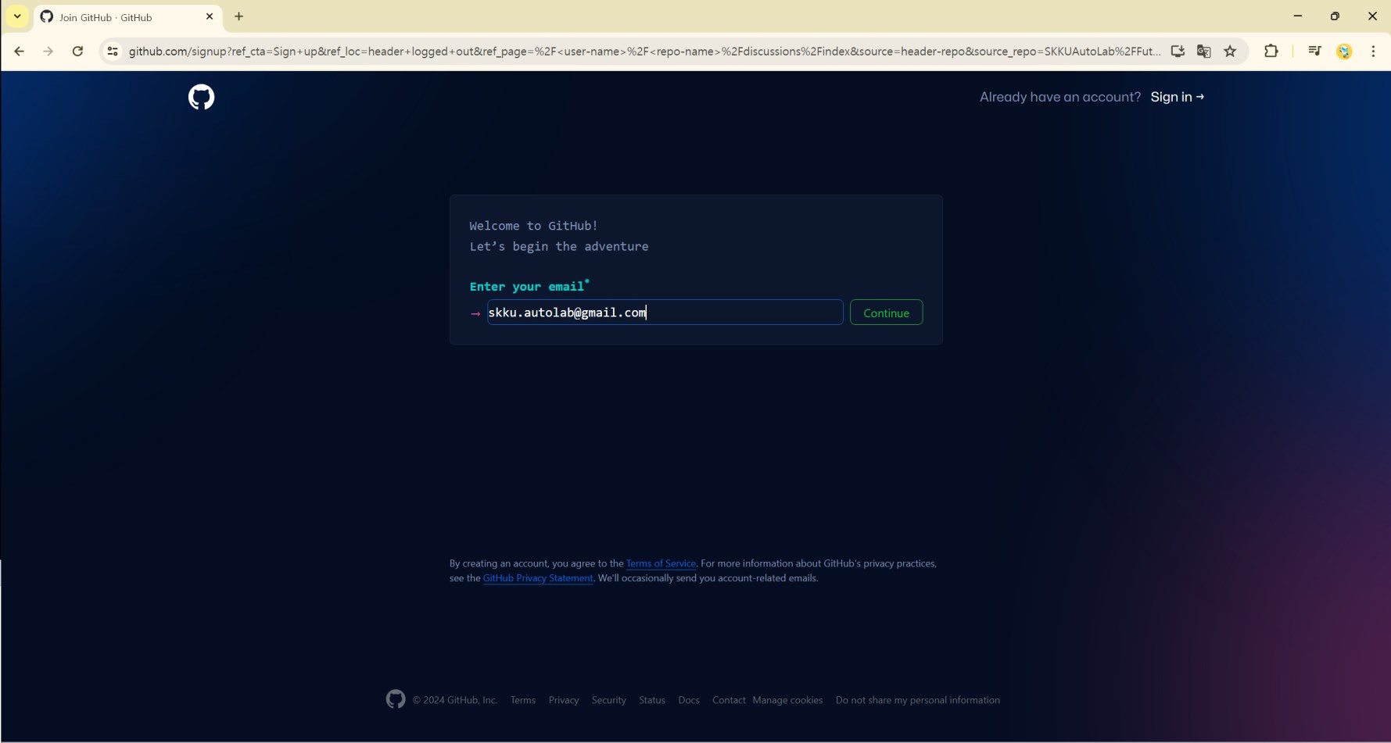
▪
Enter your email address to be used for registration, then click the highlighted section
('Continue').

Slide 10
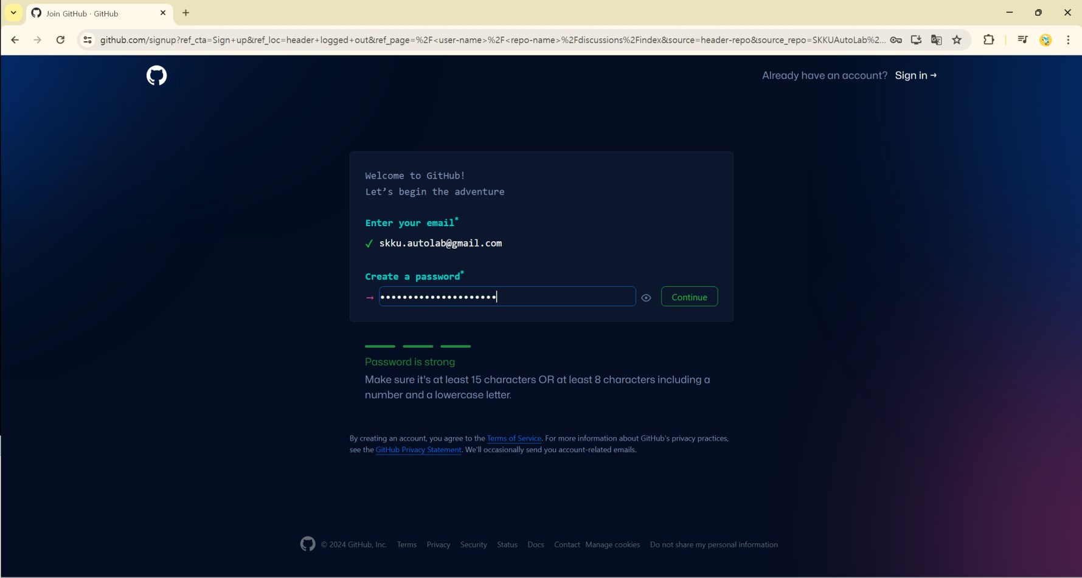
Enter the password you want to use, and click the indicated section ("Continue").
▪

Slide 11
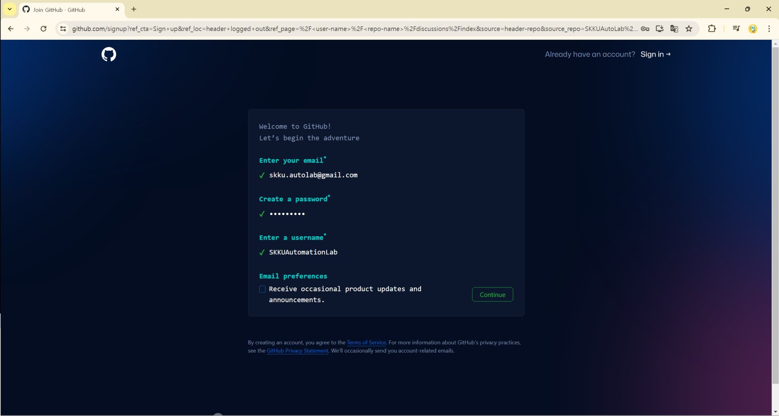
Proceed until the following screen appears, then click the indicated area ("Continue").
▪

Slide 12
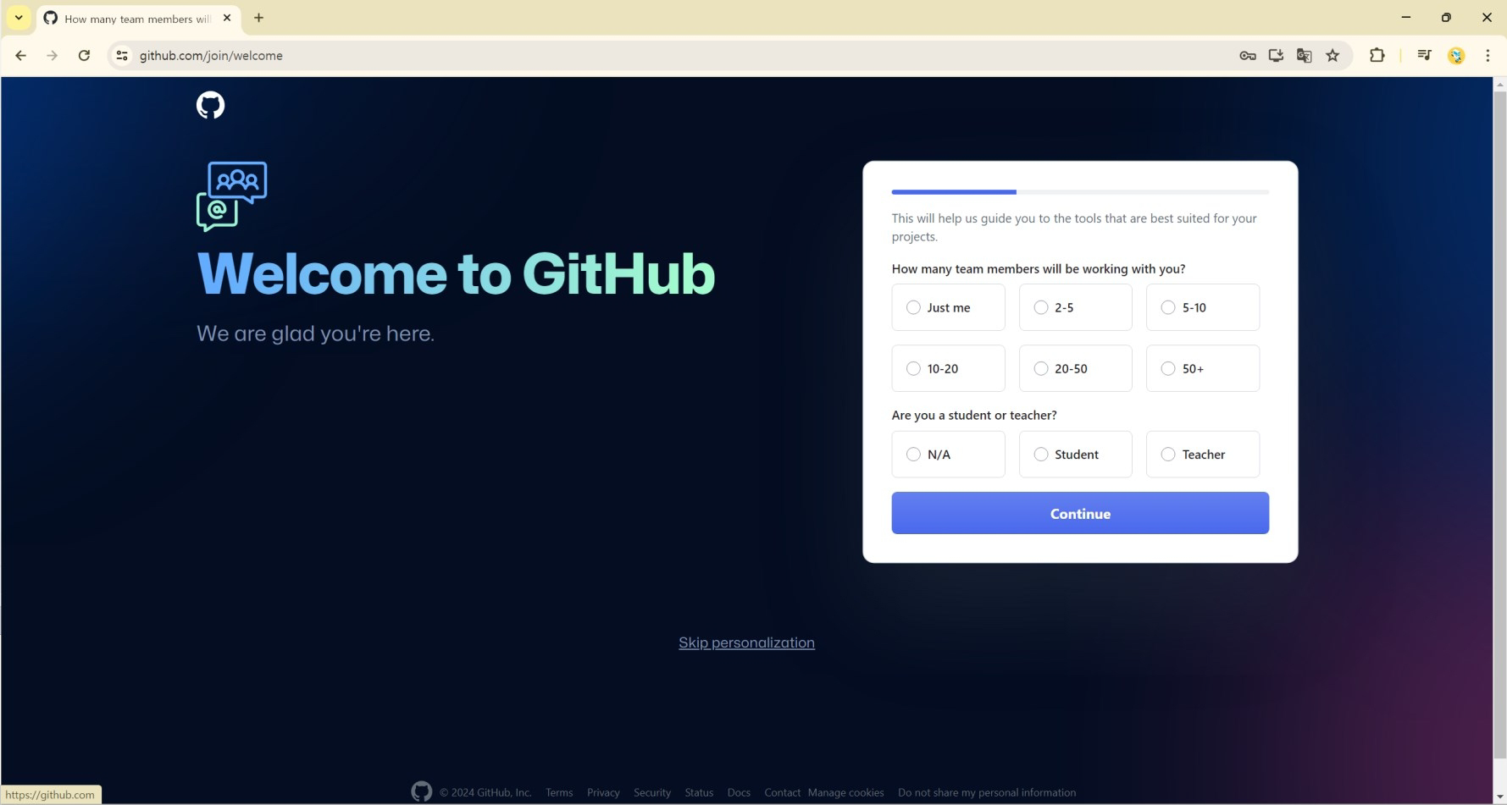

Click the indicated section ("Skip personalization").
▪

Slide 13
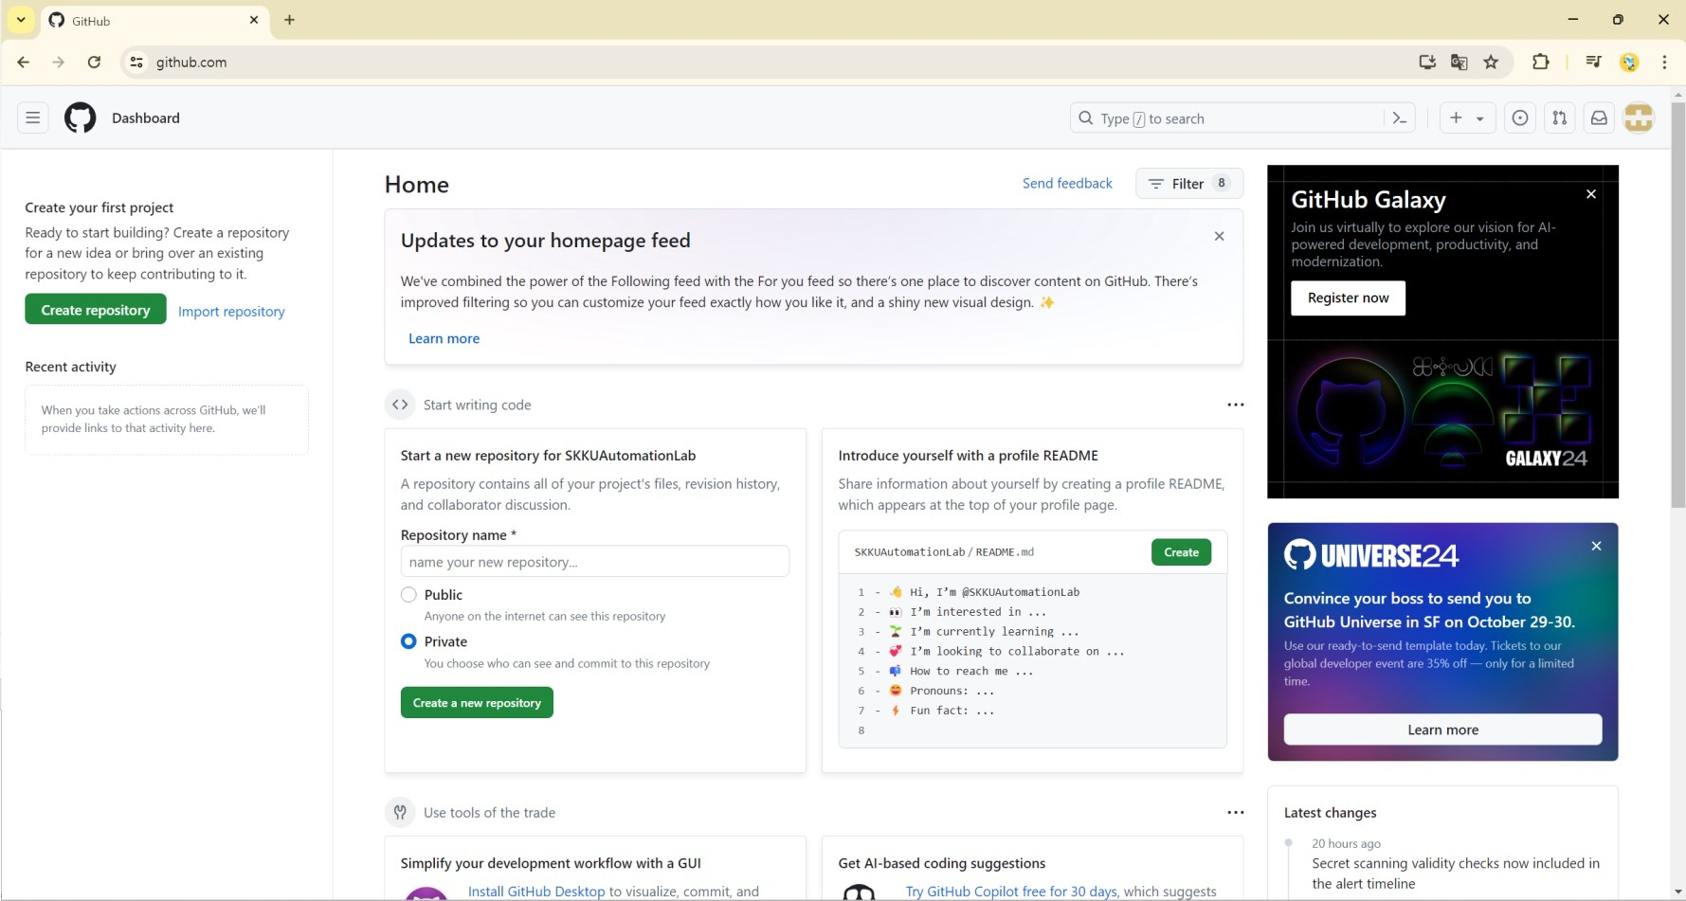

Once registration is complete, the following screen will appear.
▪

Slide 14
How to ask the question

Slide 15
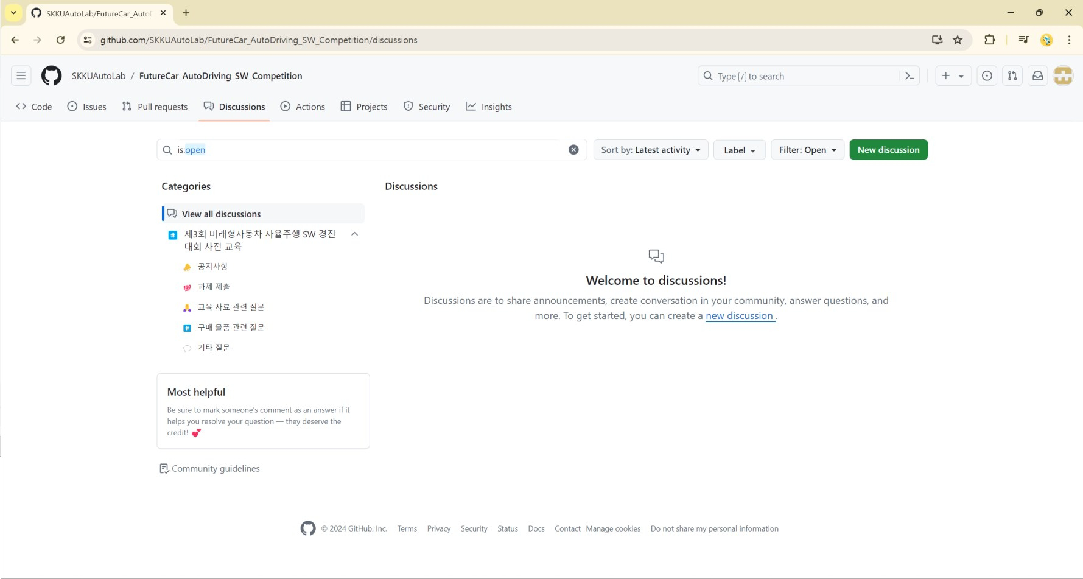

When you access the site via the link, the following screen will appear.
▪

Slide 16

You will notice that the 'New discussion' button has appeared, unlike before.
▪

Slide 17
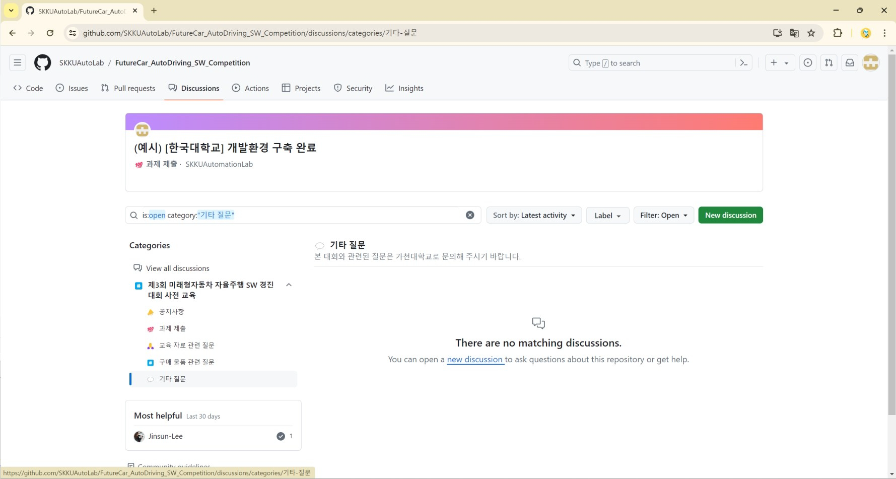

Navigate to the category appropriate for your question.
▪

Slide 18
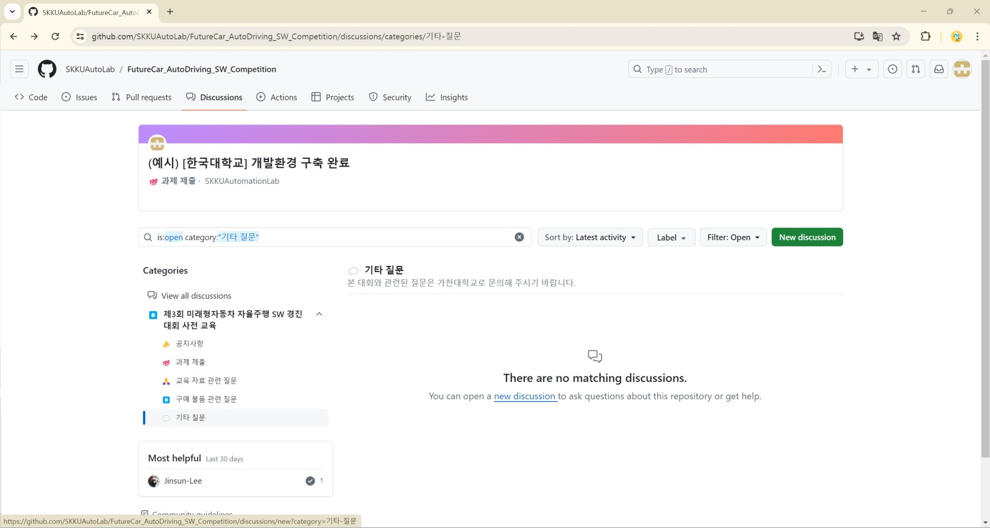

Click on the highlighted section ("New discussion").
▪

Slide 19
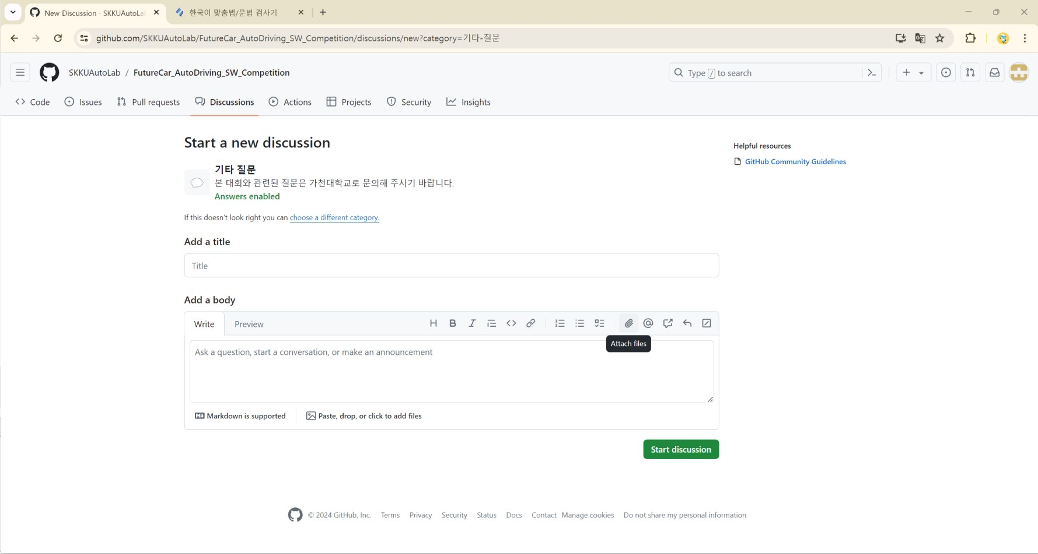

After writing your question, click the highlighted section ("Start discussion").
▪

Slide 20
How to submit assignments

Slide 21
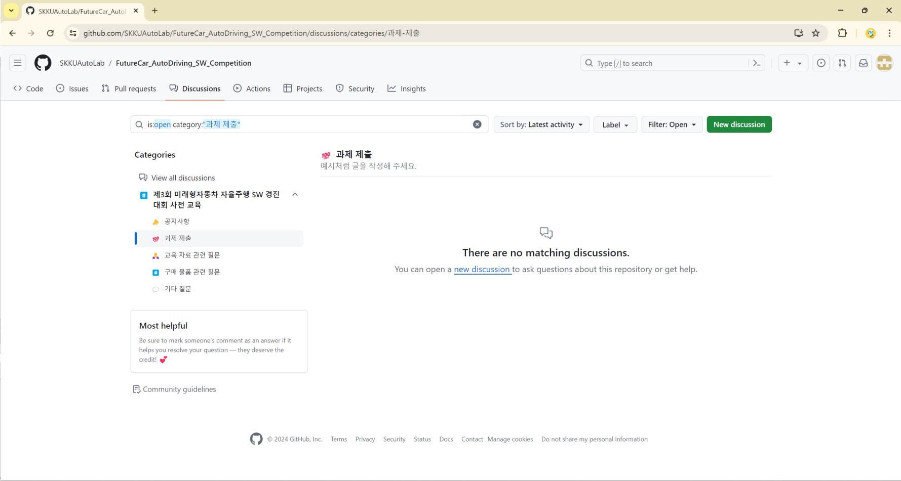

Go to the 'Assignment Submission' category.
▪

Slide 22

Click the highlighted section ('New discussion').
▪

Slide 23
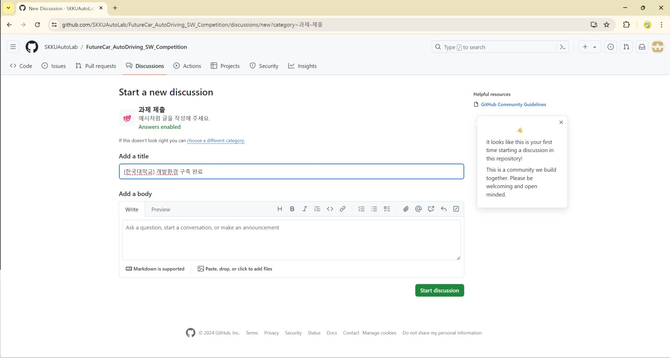

[XX University] Development Environment Setup Complete
▪

Slide 24
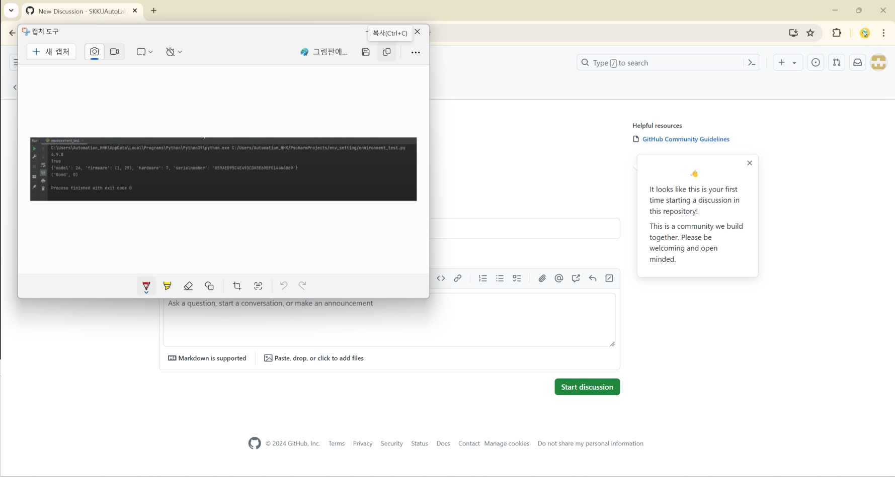

Copy the image of the execution results you wish to submit.
▪

Slide 25
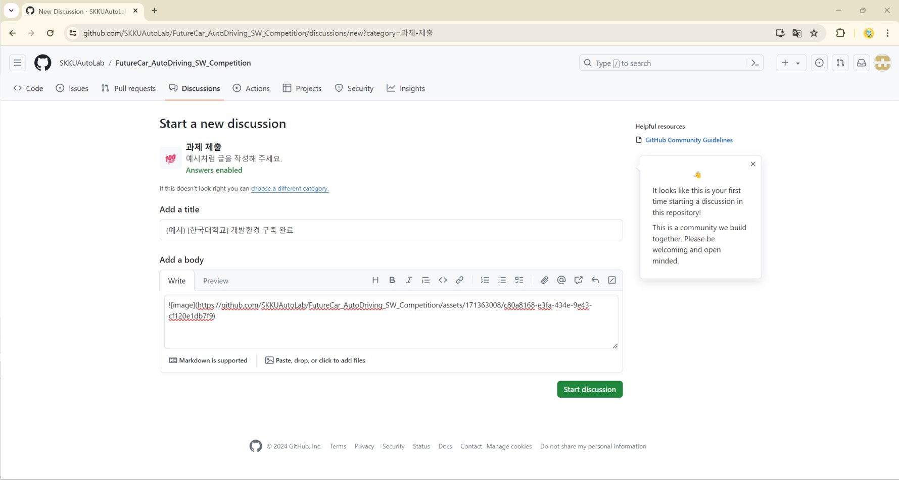

Pasting it into the content section will add the image.
▪

Slide 26
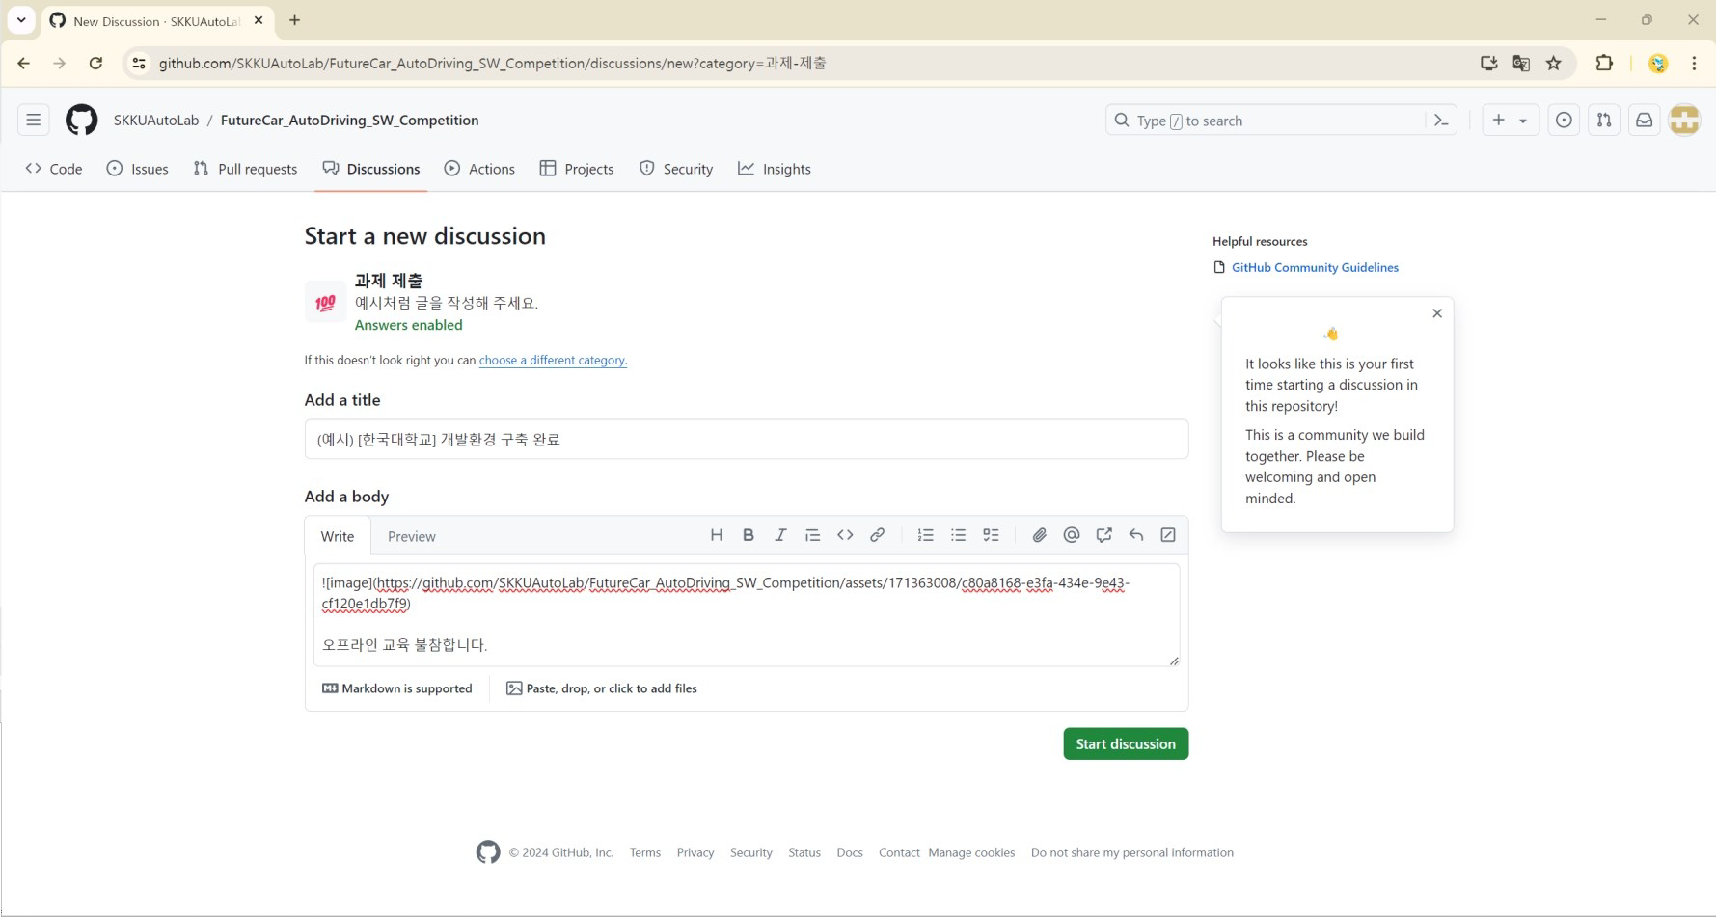

Also indicate whether you participated in the offline training.
▪

Slide 27
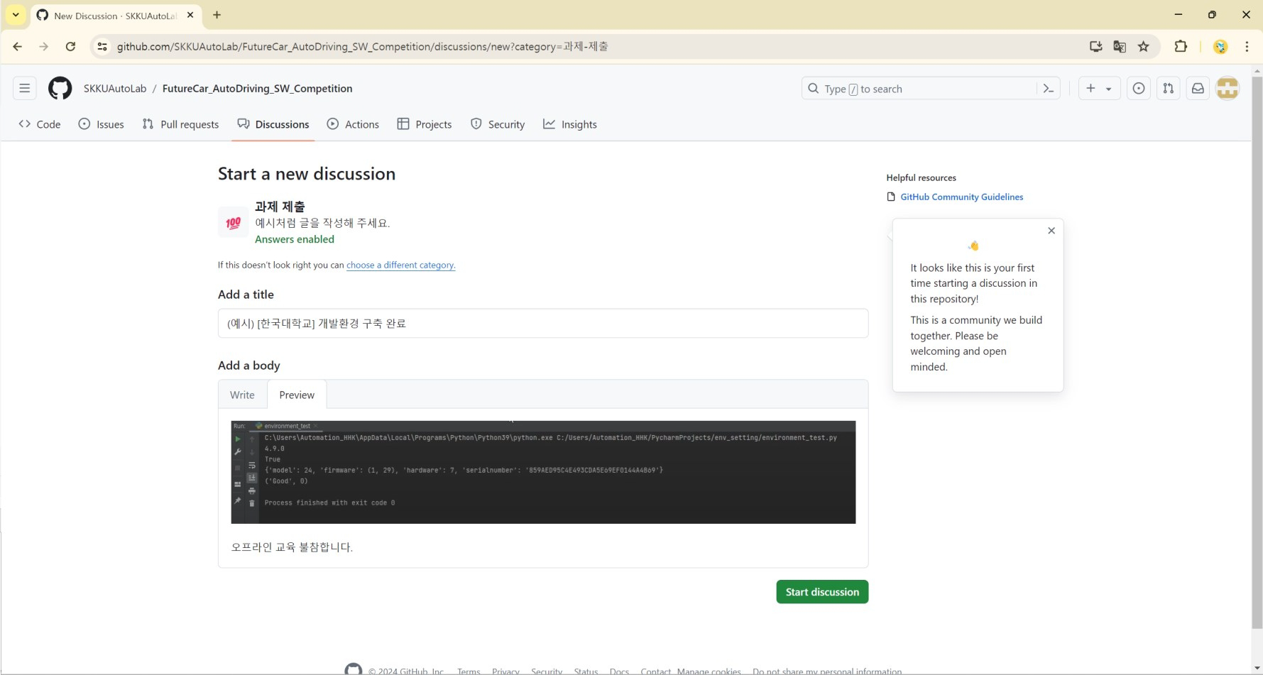

Click on the highlighted section ("Preview") to review the content.
▪

Slide 28
Click on the highlighted section ("Start discussion") to submit your assignment.
▪

Slide 29
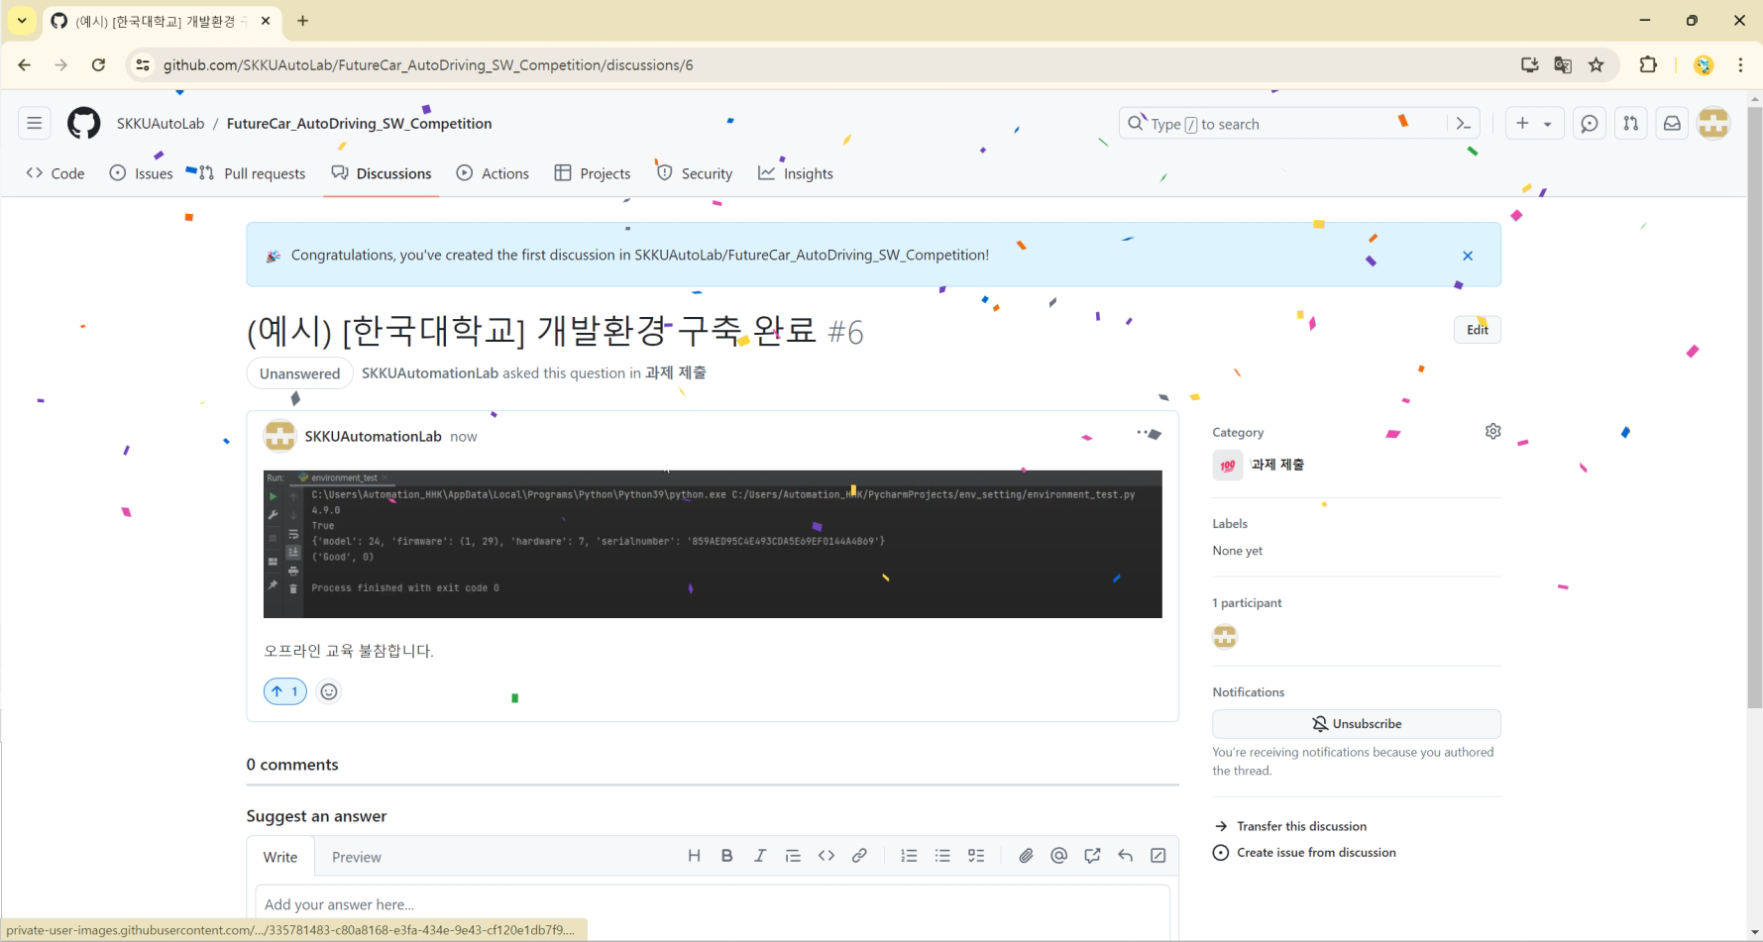
Assignment submission confirmation
▪

Slide 30
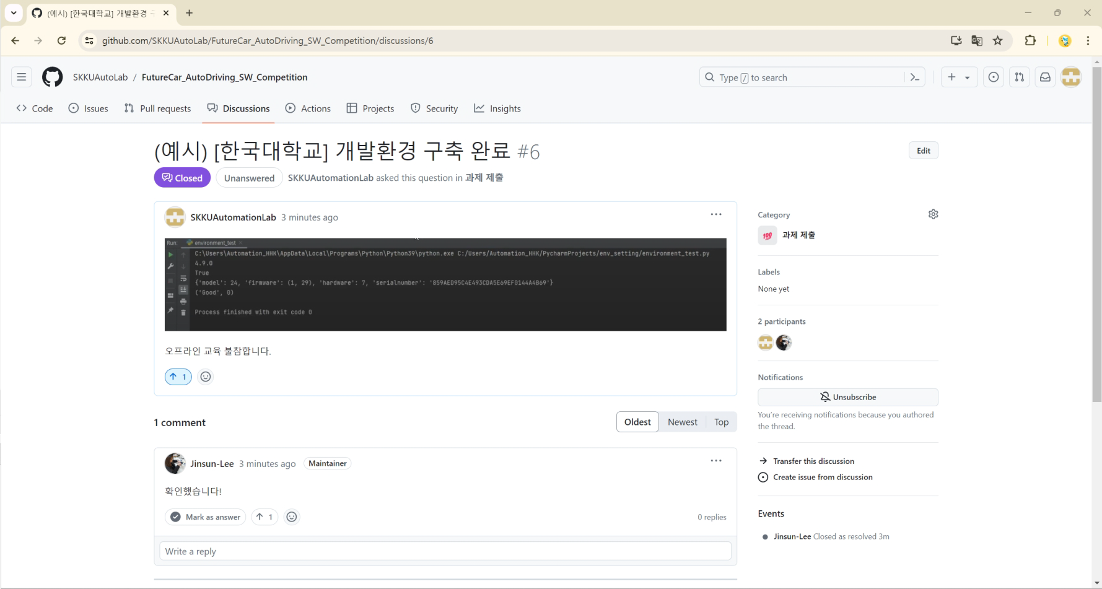

Once the teaching assistant has confirmed your assignment and participation, click the marked section ('Mark as answer').

Slide 31
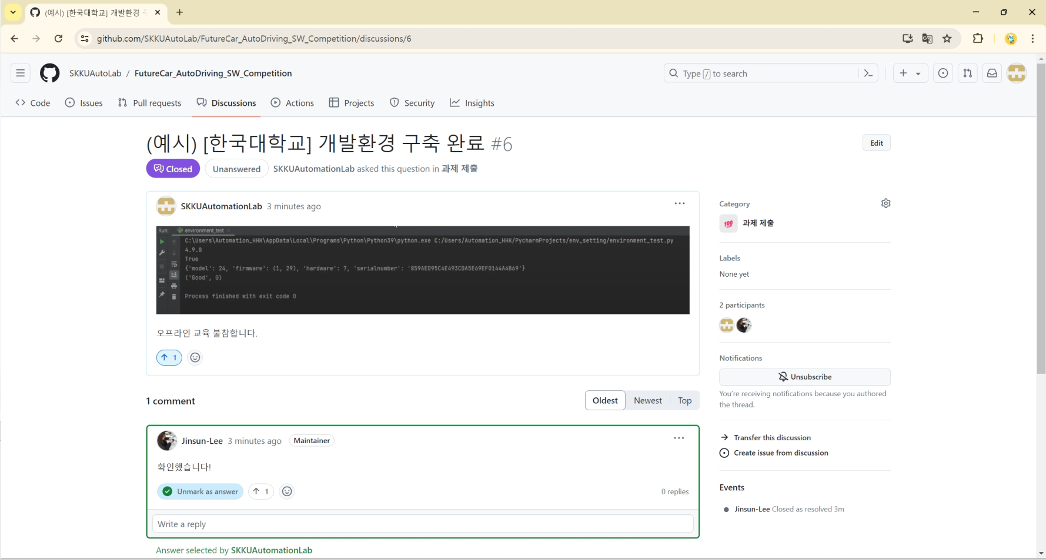

Assignment submission complete
▪

Slide 32
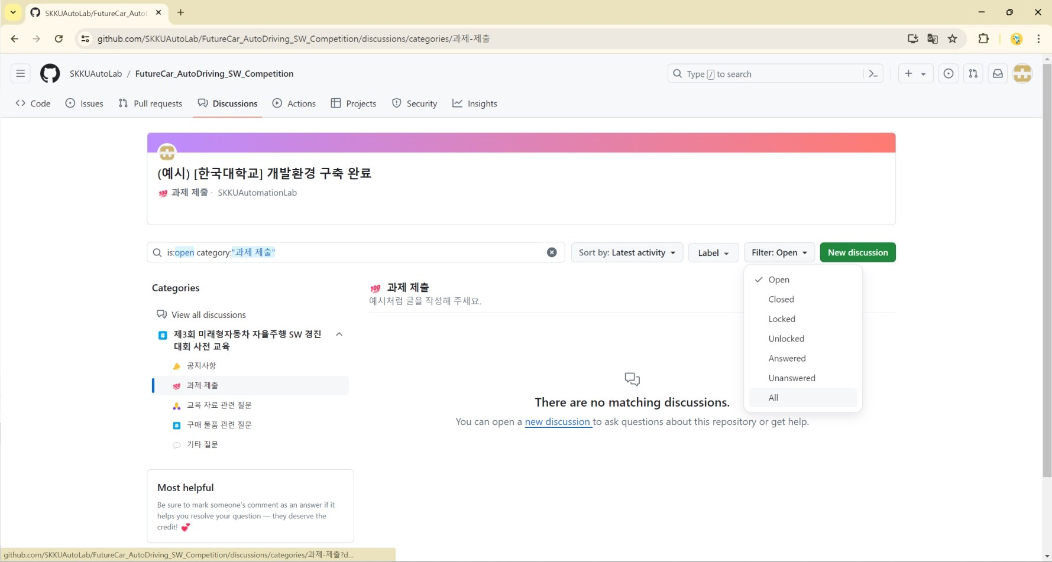

*If the submitted assignment is not visible, set it to 'Filter-All' as shown.
▪

Slide 33
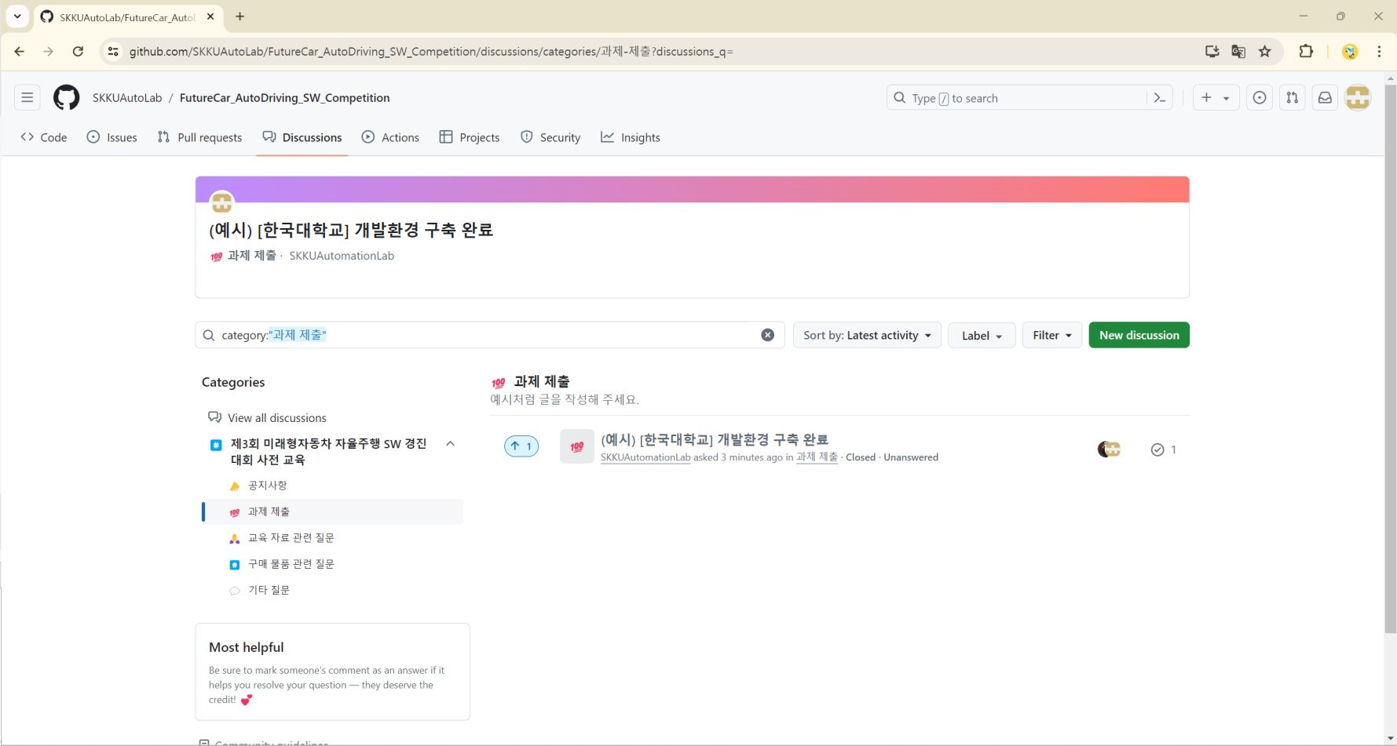
You can check the assignments you have submitted.
▪

